Slide 1
Function Communication
Functions communicate to each other to exchange data. The data flow between the calling and called functions can be divided into three strategies: a downward flow, an upward flow, and a bi-directional flow.
Topics discussed in this section:
Basic Concept
C Implementation

Slide 2
Note
The C language uses only call by value and return to achieve different types of communications between
a calling and a called function.
Call by value: value of parameter is passed,
so changes made to parameter in function are
not reflected in the calling function.

Slide 3
Downward Communication in C

Slide 4
Downward Communication

Slide 5
Upward Communication in C

Slide 6
Upward Communication

Slide 7
Note
To send data from the called function to the calling function:
1. We need to use the & symbol in front of the data variable when we call the function.
2. We need to use the * symbol after the data type when we declare the address variable
3. We need to use the * in front of the variable when we store data indirectly

Slide 8
Bi-directional Communication in C

Slide 9
1
Bi-directional Communication

Slide 10
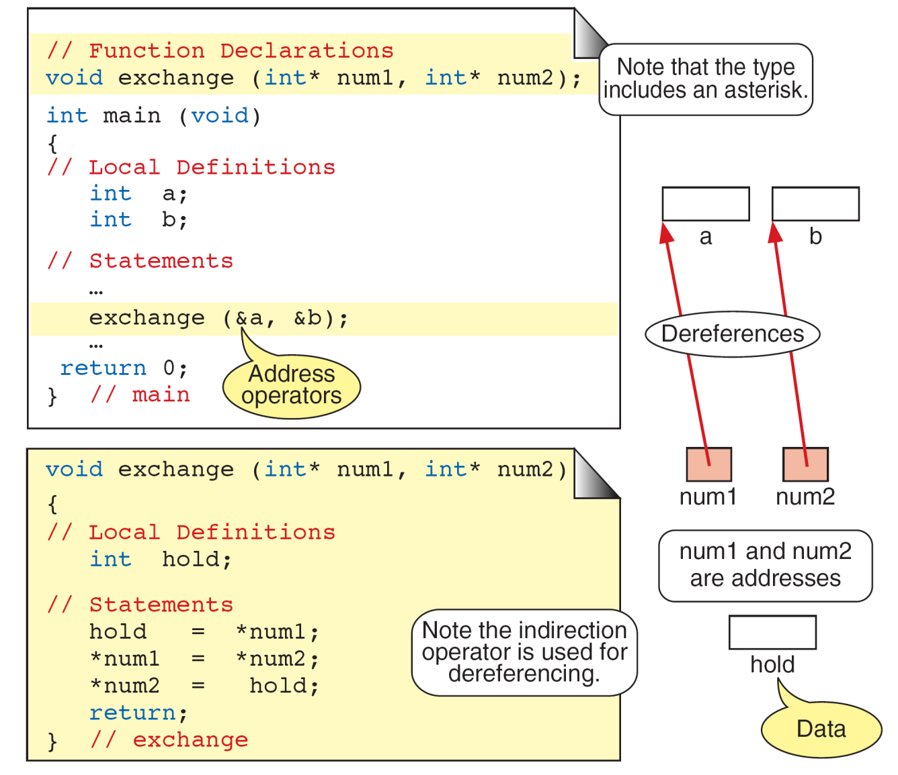
Exchange Function

Slide 11
Calculate Quotient and Remainder

Slide 12
Quotient and Remainder

Slide 13
Quotient and Remainder

Slide 14
Quotient and Remainder

Slide 15
Quotient and Remainder

